Slide 1
Connect the Dots
Quantitative Isothermal Amplification Machine Learning
Notes:
Luke

Slide 2
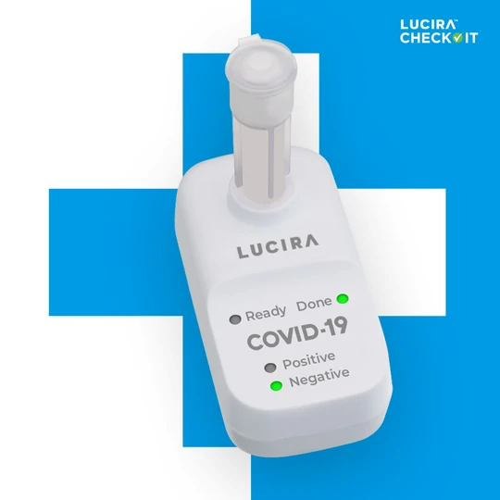
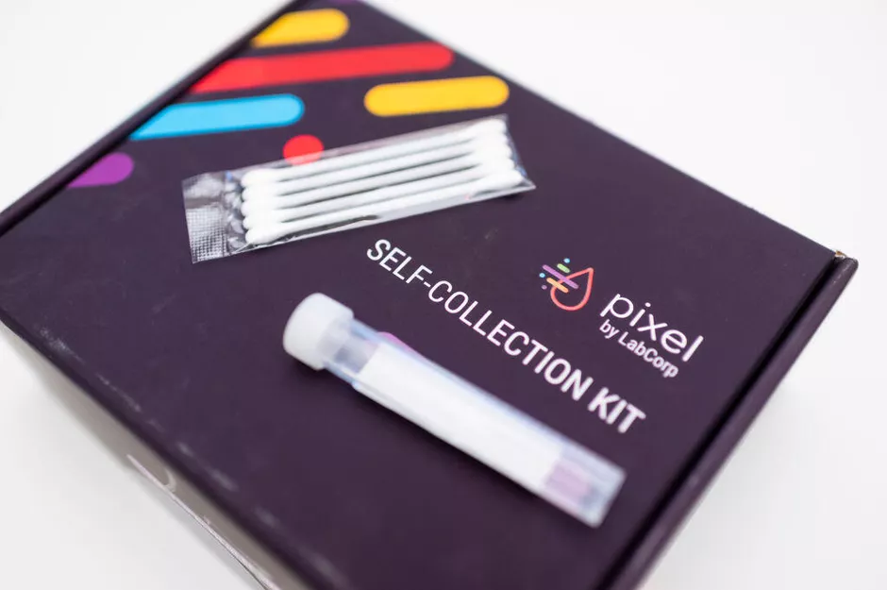
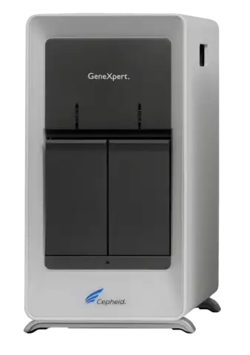
State of the art:
HOME BASED COLLECTION-PCR
POC PCR
ISOTHERMAL ASSAY
Pixel by Labcorp COVID-19 Test Home Collection Kit
Lucira Check It COVID-19 Test
Cepheid GeneXpert
For COVID the FDA has provided emergency use authorization to 266 home-based collection and 3 isothermal assays for home based COVID diagnosis.
Notes:
Luke

Slide 3
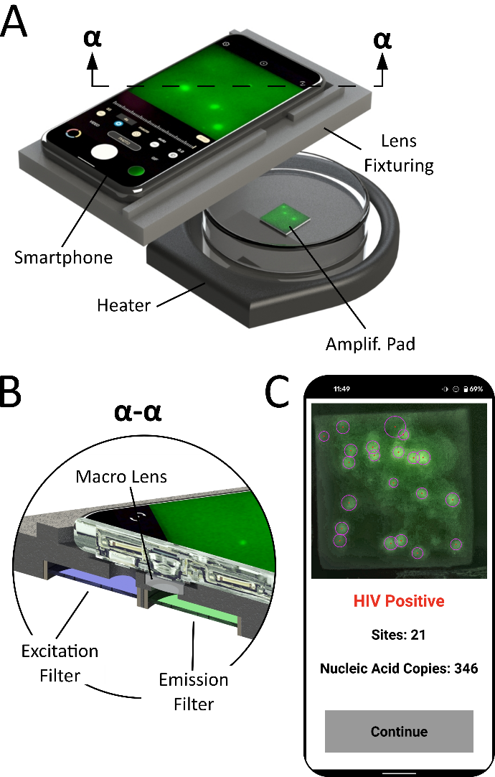
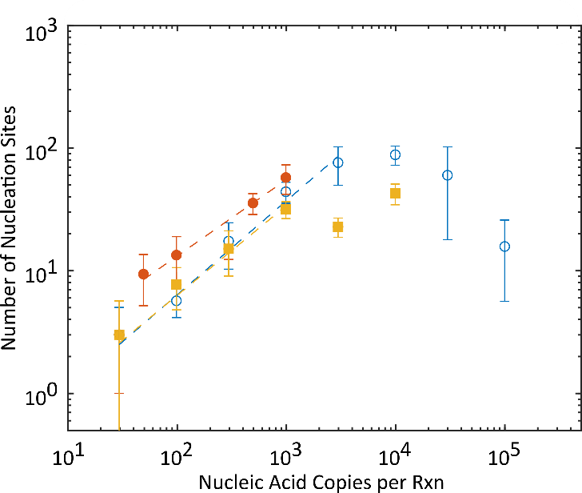
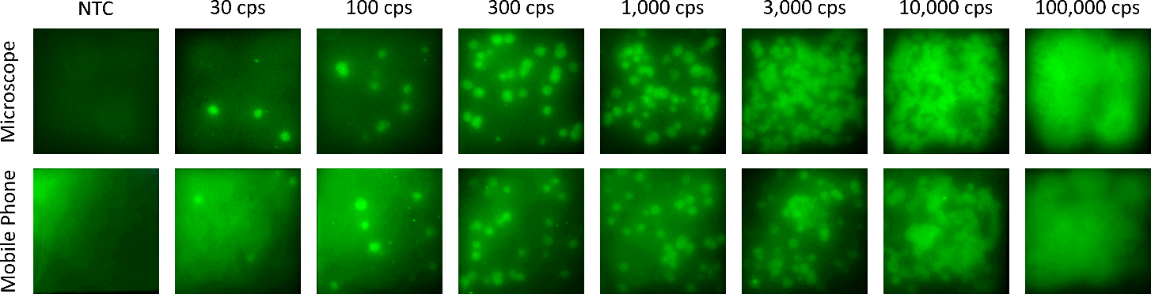
Our Project

Slide 4
Description of Software
Can this data be utilized in a machine learning model to improve quantifiable range?
set out to produce a regression model
due to lack of data produced a 3 classification ML CNN
User supplies an endpoint reaction picture picture
Three classification CNN predicts input concentration based on High, Medium, and Low input copies
The image is displayed with along with input copy prediction on interactive website.

Slide 5
Data Science Methods
Image pre-processing using OpenCV
Image data read-in to a tensorflow dataset
sequential model
2D convolution 8 neurons
flattening
Dense layers 16 neurons
Optuna used to optimize hyperparameters
activation
optimizer
Limited data size
0 batch training
50% validation split
Visualized with Streamlit

Slide 6

Summary
Conclusion on Project
Model trained on seven images had accuracy of ~40%
Preliminary website design
Project structures
Proof of concept
What we learned
Analyzing user cases
Using Github for version control
More practices with python
Next step
Try to model with other methods
Include time-dependent parameters
Polish the website design
More tests for functions

Slide 7
Questions?

